Slide 1

Years-Long Image Broadcast using Bluetooth Low Energy Beacons
Chong Shao
Notes:
I will talk about the project we did at UNC chapel hill
The title is …
25 – 27 min
deeper reason for it being such long lifetime, no pairing, shorter range (50m), low data thourghput

Slide 2




BLE Beacon technology
StickNFind
Qualcomm Gimbal
RedBear Beacon B1
Estimote
GeLo
KST Particle
http://localz.com/blog/ibeacon-ble-hardware-commercial-comparison/
http://blog.estimote.com/post/57087851702/preorder-for-estimote-beacons-available-shipping
Devices that broadcast small pack of data to nearby portable electronic devices.
Protocol designed to enable devices with low power consumption.
Only transmits small packets.
Long lifetime: 3~5 years
Notes:
Recently become popular,
BLE devices are usually called beacons, what they do is…
Protocol is designed to ...
The devices using this protocol only... So that power consuption is very low
Estimote broadcasting signal for 3~5 years
many models on the market, with cheap price, each costs several dollars
Apple/google protocol based on xxx /SDK,

Slide 3

BLE Beacon technology application
Customer behavior analysis: Pierdicca et al. (2015)
Indoor localization: Martin et al. (2014)
Room occupancy detection: Conte et al. (2014)
http://prismdevkit.com/lesson-8-an-intro-to-estimote-beacons/
Notes:
Shows typical use case
System briefly knows where you are
-This technology enables applications in several domains including ….
-serie of Use cases:
Customer can get advertisements in the entrance, do automatic checkin and rewarded with coupons,
With indoor location feature, the beacon delivers to cumster the information of the products that are close to the customter,
They can even do smooth checkout withit

Slide 4
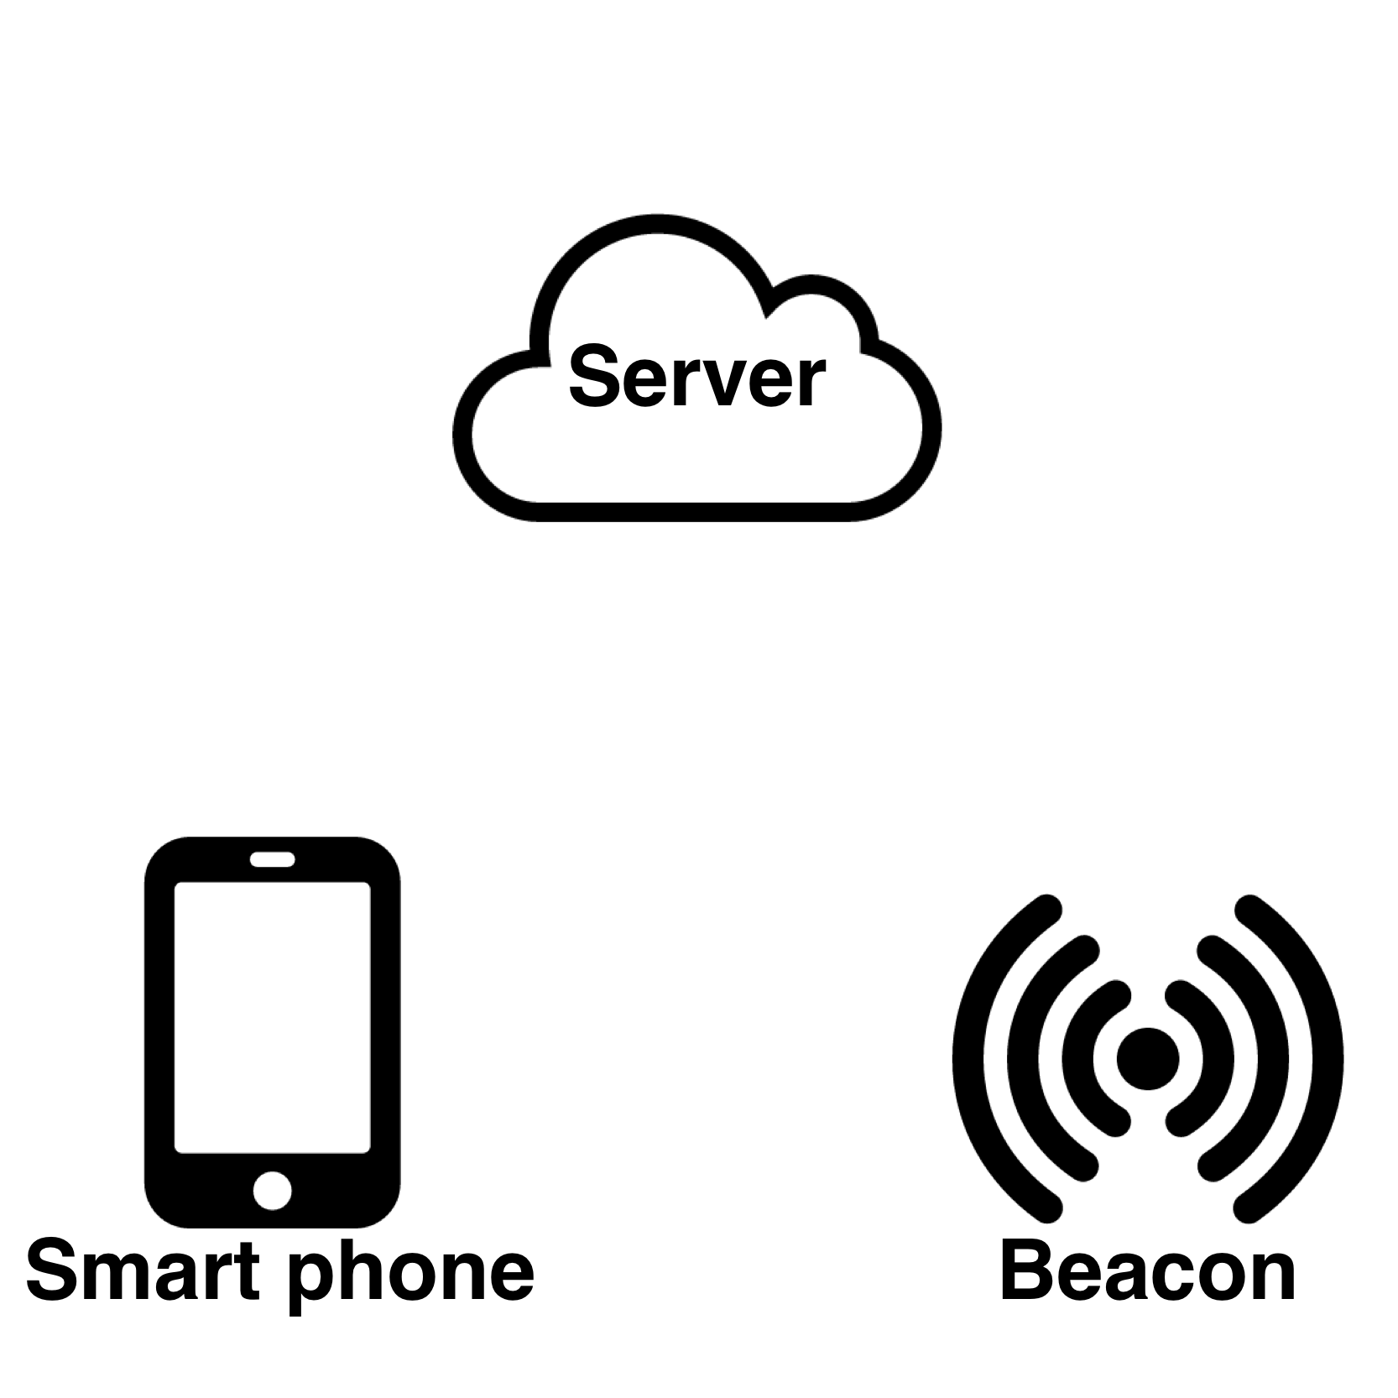
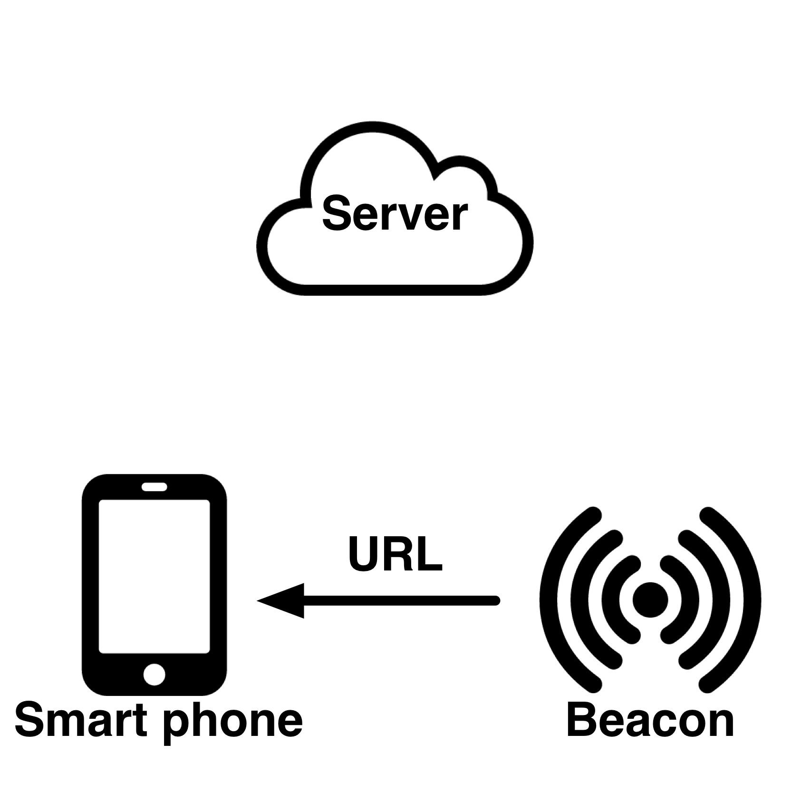
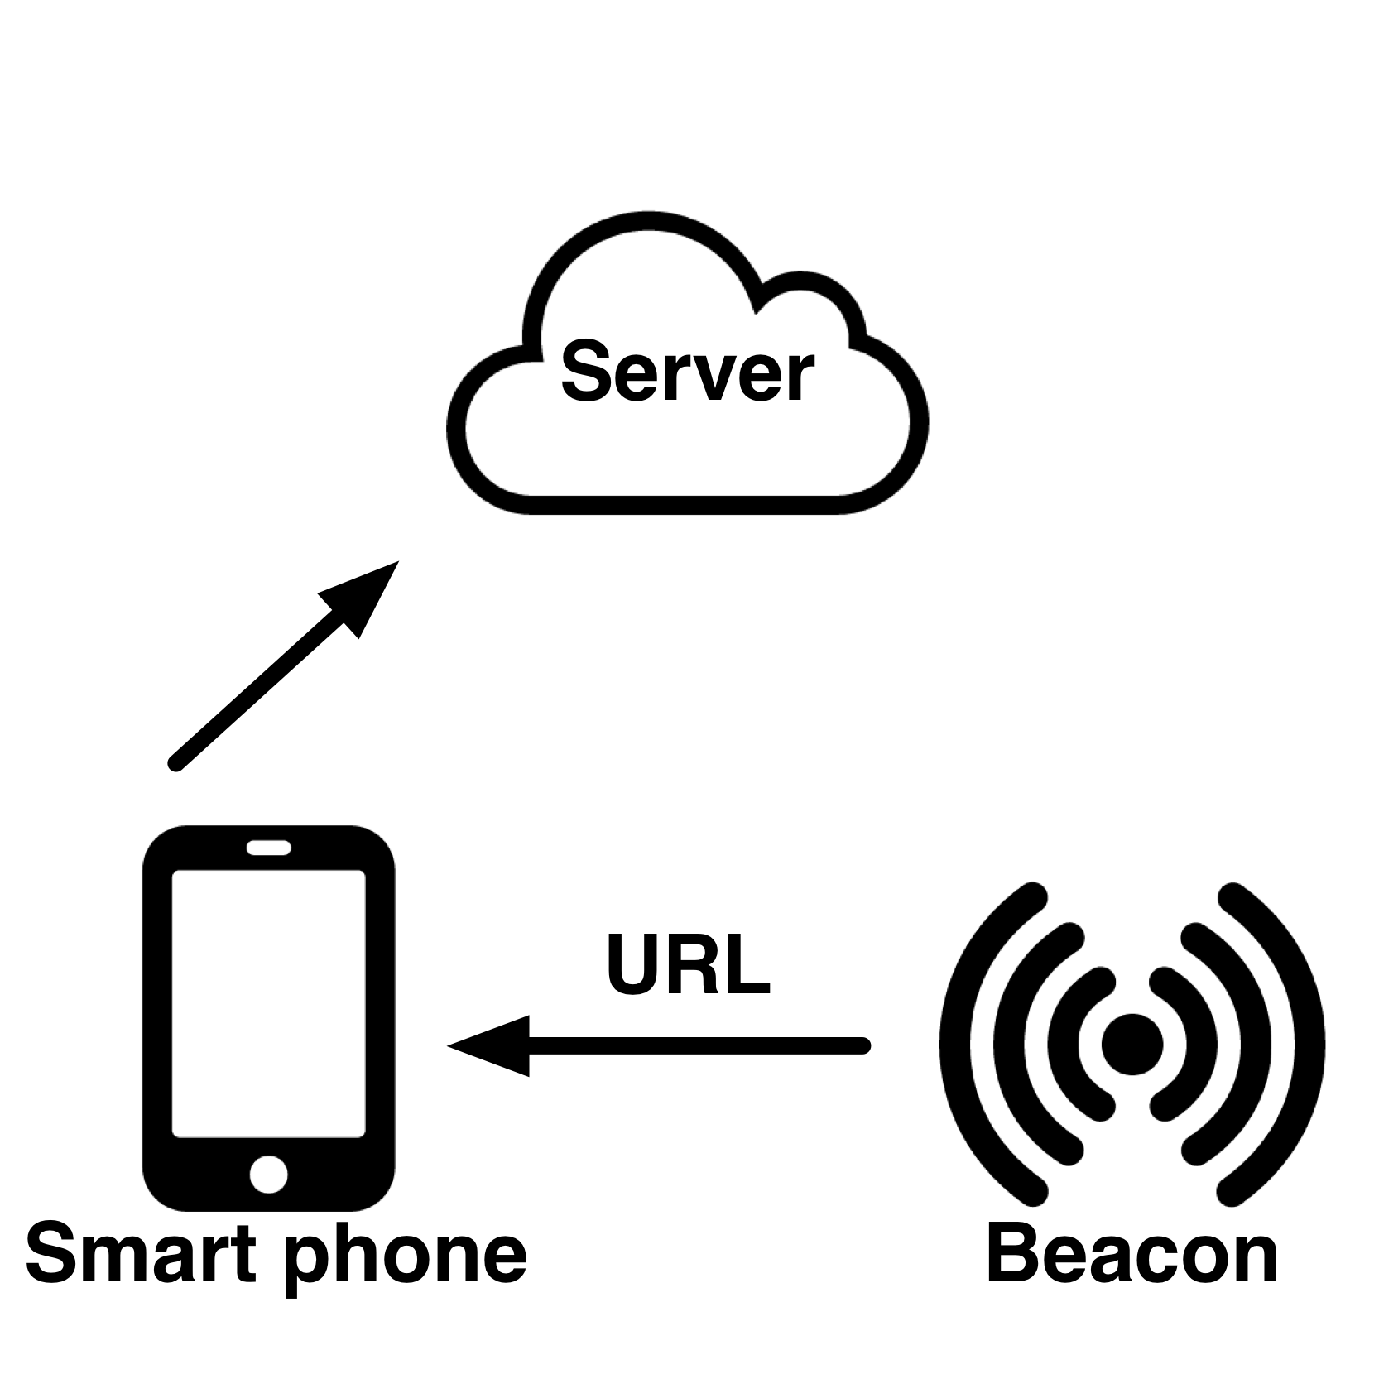
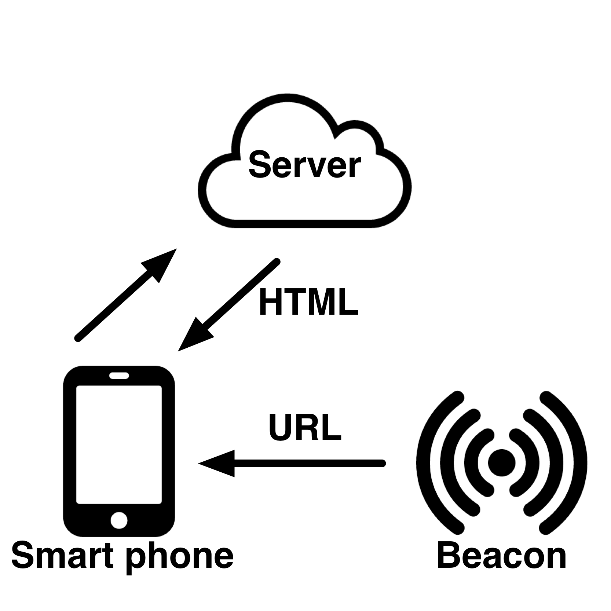
BLE Beacon technology
Notes:
Diagram shows Typical data flow of beacons servcice
Phone needs to have internet connection
Mention what are these arrows mean, beacon to smart phone: 18 byte packets, (URL, HTML, etc)
Use some animations,

Slide 5
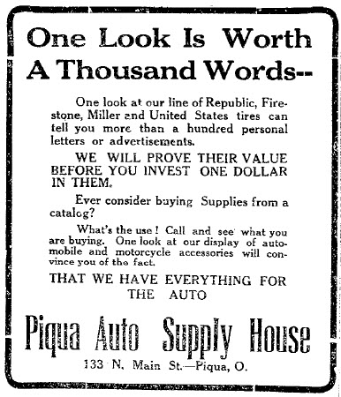
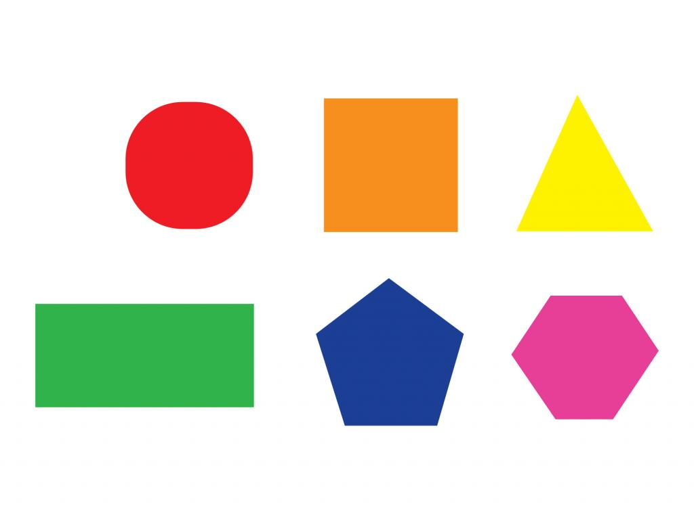




How about images?
What if we want to let Beacon broadcasting images?
https://www.tes.com/lessons/S8VtfCaXvNCH4w/shapes
https://openclipart.org/detail/223635/exit-sign
http://www.promarksigns.com/
http://www.vectorportal.com/StockVectors/Icons/GREY-PRINTER-ICON/17769.aspx
https://www.iconfinder.com/icons/389375/brew_brewing_cafe_coffee_coffee_machine_coffee_maker_cup_drink_espresso_expresso_machine_maker_icon
Notes:
It will be much more useful if beacon can broadcasting images
Motivication can be explained by this 1913 newspaper advertisement, image worth 1000 words
Beacon that broacdasting images will provide us with opportunities that to play with images that has connection to the physical world such as …
https://en.wikipedia.org/wiki/A_picture_is_worth_a_thousand_words
TODO: cite the 1913 image

Slide 6
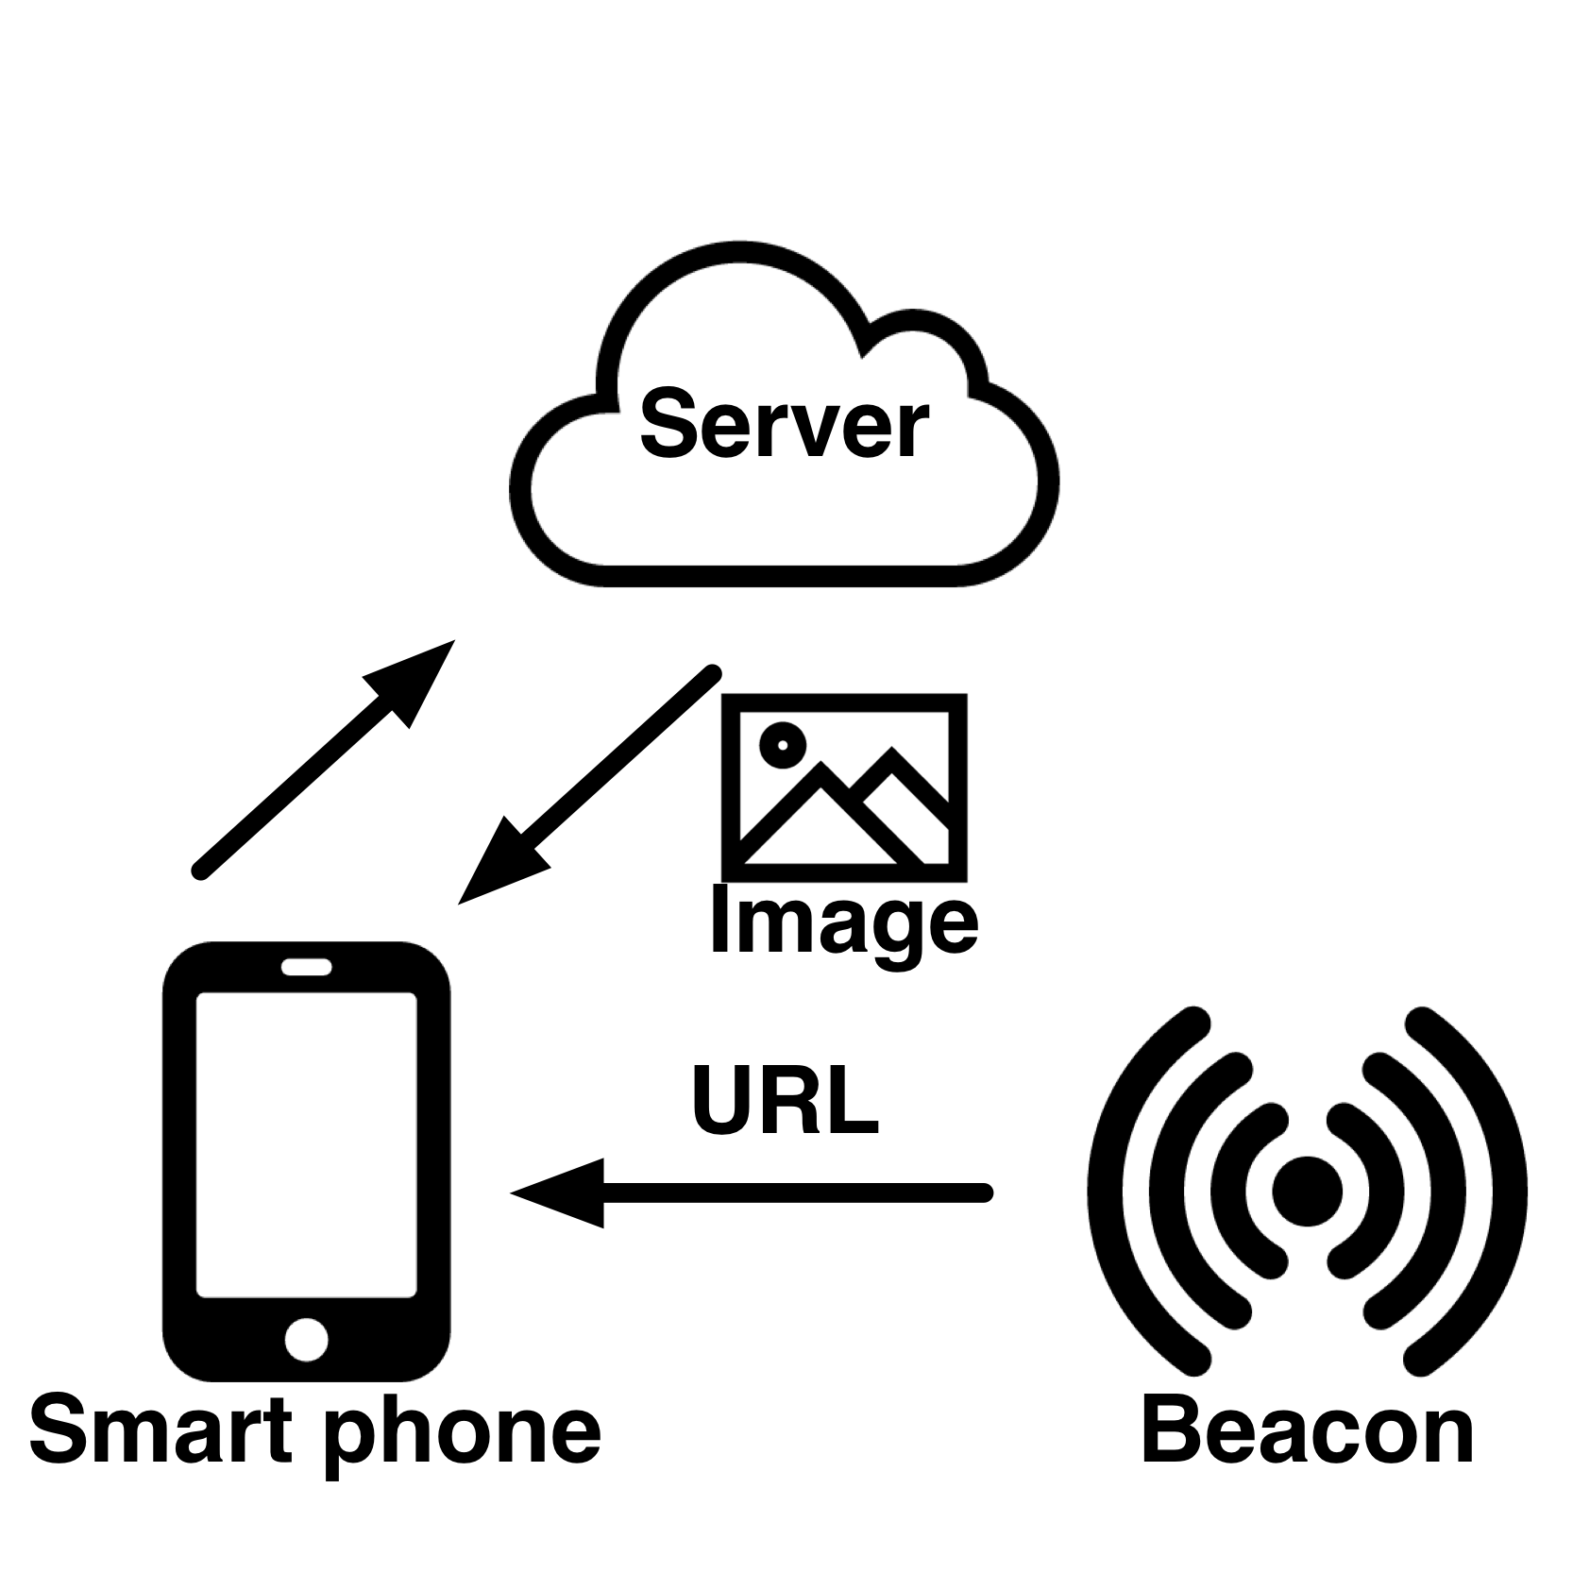
How about images?
Notes:
This feature is covered by the previous data flow -
Data flow for images

Slide 7




What if there is no Internet connection?
http://www.sierraclub.org/sierra/activism/saving-wild-places?page=7
Notes:
but .....
Imaging in a Wild place without internet connection, you still want to retrieve rich multimedia such as images data from beacon
This is useful because a traveller doing Hiking can write custom images presents useful information such as navigation signs into beacon
And drop the beacon
So other people come later. And it will last for years.
Surveillance camera connect to beacons taking pictures and people can use a drone can fly close to retrieve the images

Slide 8
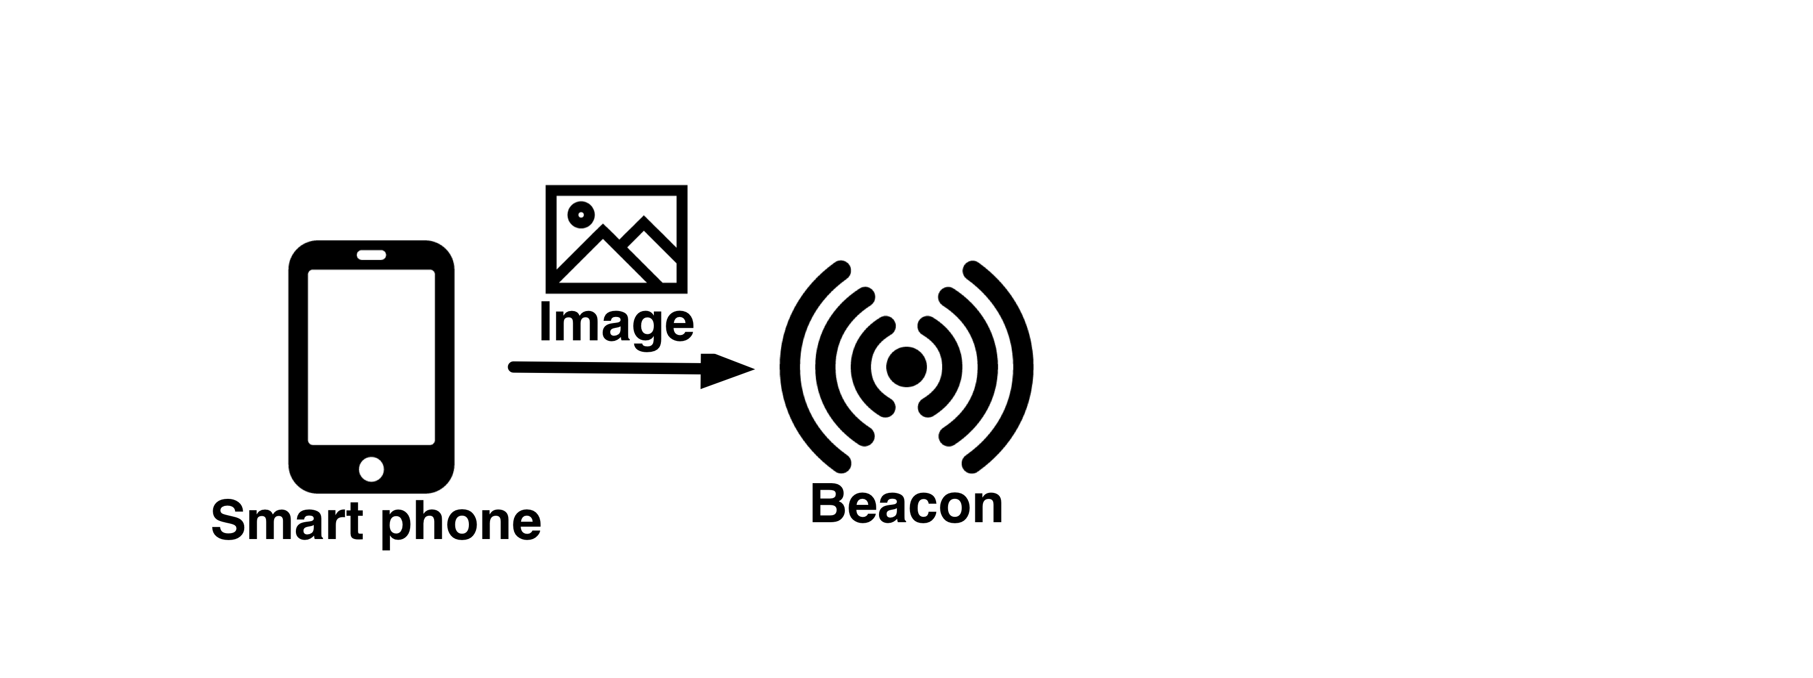
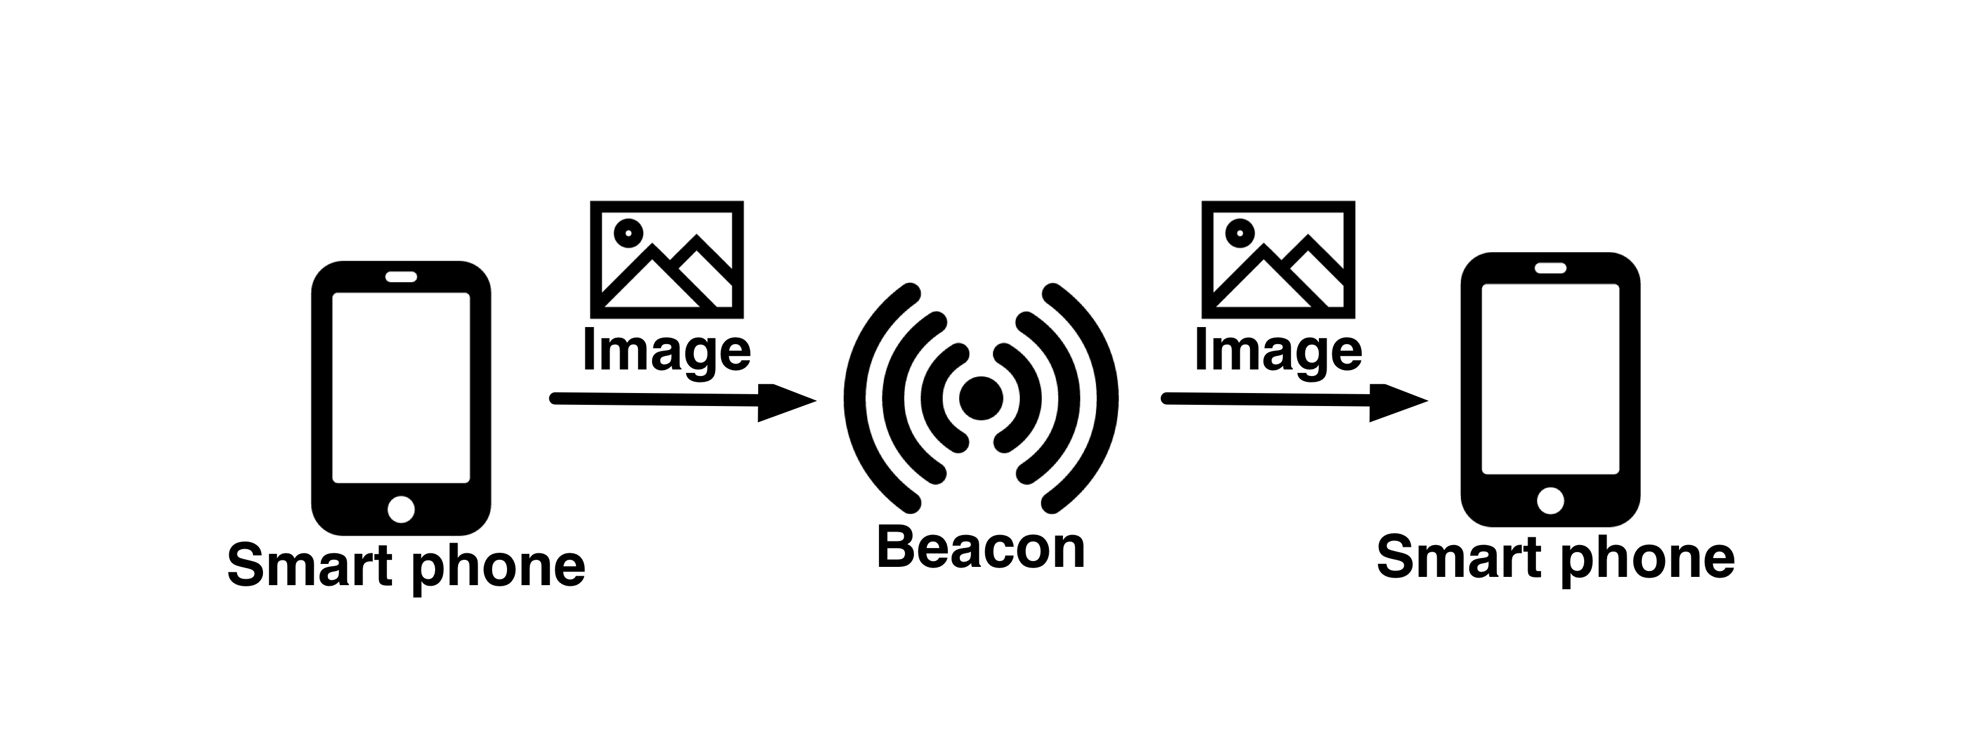
Store image data into Beacons
No Internet connection!
Short
delay
Lifetime: 3~5 years
Notes:
-in order to implement this, we would like to have such different data flow
-and the system has the property such as Lifetime statement (years long),
- Another portable device such as a smart phone will get the image if it goes close to the beacon
-thanks to the BLE technology, receiving of the image will have short delay
-No internet connection

Slide 9
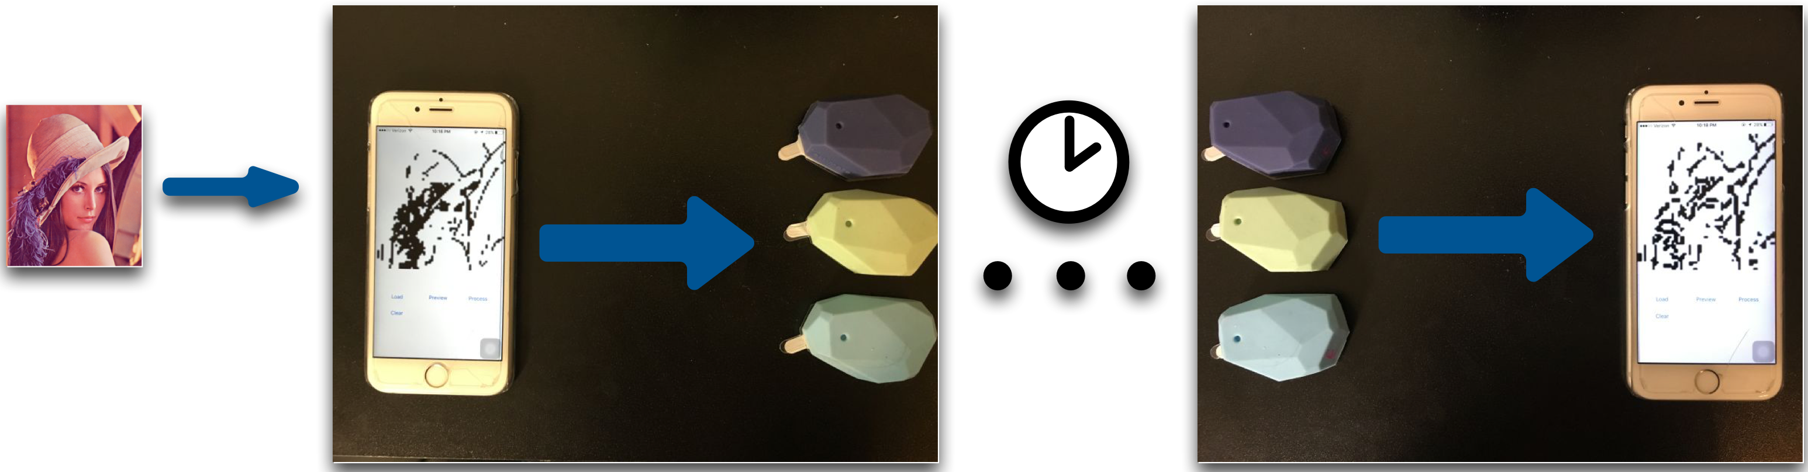
Store image data into Beacons
Reader
App
Input Image
Writer
App
Estimote
Beacons
Notes:
We implemented this system
We wrote a writer app Having an input image, we convert it into a form that is capable to be stored into three beacons
－ Smart phone app

Slide 10

Challenge
iBeacon packet format
Limited broadcasting data packet size
4 Bytes in iBeacon mode (UUID is not changeable via API)
18 Bytes using Eddystone URL mode
Future: BLE 5.0 with 8x broadcasting capacity: ~256 bytes
-> We must compress the images
http://www.argenox.com/bluetooth-low-energy-ble-v4-0-development/library/a-ble-advertising-primer/
Notes:
TODO: find deeper hack’s memory limit
-The major challenge we face is the extremly limited storage space of BLE beacons
-Diagram iBeacon packet foramat
- With the ibeacon format and SDK, what the user can use as storage space is 4 bytes
-details: naively using the ibeacon protocol that broadcasting uuid, major and minor values, we cannot change the UUID so we only got 4 bytes each beacon
Eddystone
Deeper hack: maximum xxx bytes
A typical image with small size (64 x 64) can easily exceeds 5 thousands bytes

Slide 11
Approaches
Limit image type
(binary image, DCOSS 2016)
Select region of interest
(color image, IoTDI submission)
Customized image compression
Notes:
Another thing we can do is to constrain the image type
For each image type, there exist compression methods specifically designed for it

Slide 12






Conventional compression is not good enough
A typical simple shape 64x64 JPEG format image: 400 bytes ~ 2KB
For the “Lena” image:
Default quality
8549 Bytes
Quantization
level 20
1077 Bytes
Default quality
1382 Bytes
Quantization
Level 20
732 Bytes
Simple threshold
637 Bytes
Canny
1268 Bytes
Chain
Coding:
427 Bytes
Notes:
Put here: simple shape such as a image of disk it’s size
for a more complicated image such as Lena
The first row is all JPEG compression
JPEG is about tranferring signal into freq space and downsampling
Quantization is like downsampling in frequency space
What else is there besides JPEG? Backup slide ready for that.
Cite state of art color image compression codec
Tree-based image compression paper

Slide 13
Solution
Develop a custom image compression
Binary image compression: patch based method
Color image compression: adaptive encoding
Notes:
The solution is to develop a custom iamge compression technique that better fits this case
We developed a patch based method

Slide 14

Patch-based compression
Patches are matched based on Structural Similarity (SSIM)
Beacons store / broadcast indices of patches
Notes:
Each grid is similar to this patch
To geenrate the set of patches, one approach that acdtually works very well is to use spiral images
“Having one spiral does not always help,
Having an array of spirals is more effective “

Slide 15

Patch-based compression
Set of spiral patches derived from K-means clustering

Slide 16


Compression result
CR: compression ratio
Notes:
Morphology: small island removed, connected component enhanced
Using a very trivial encoding: store all indices, the compression ratio is already very good
This plot comparison between our method and JPEG
In some areas, you can have some images what my method works better than jpeg: better quality and lower size.
Blue: you need around half a dozen or two dozen
Red: 2 or four beacons

Slide 17
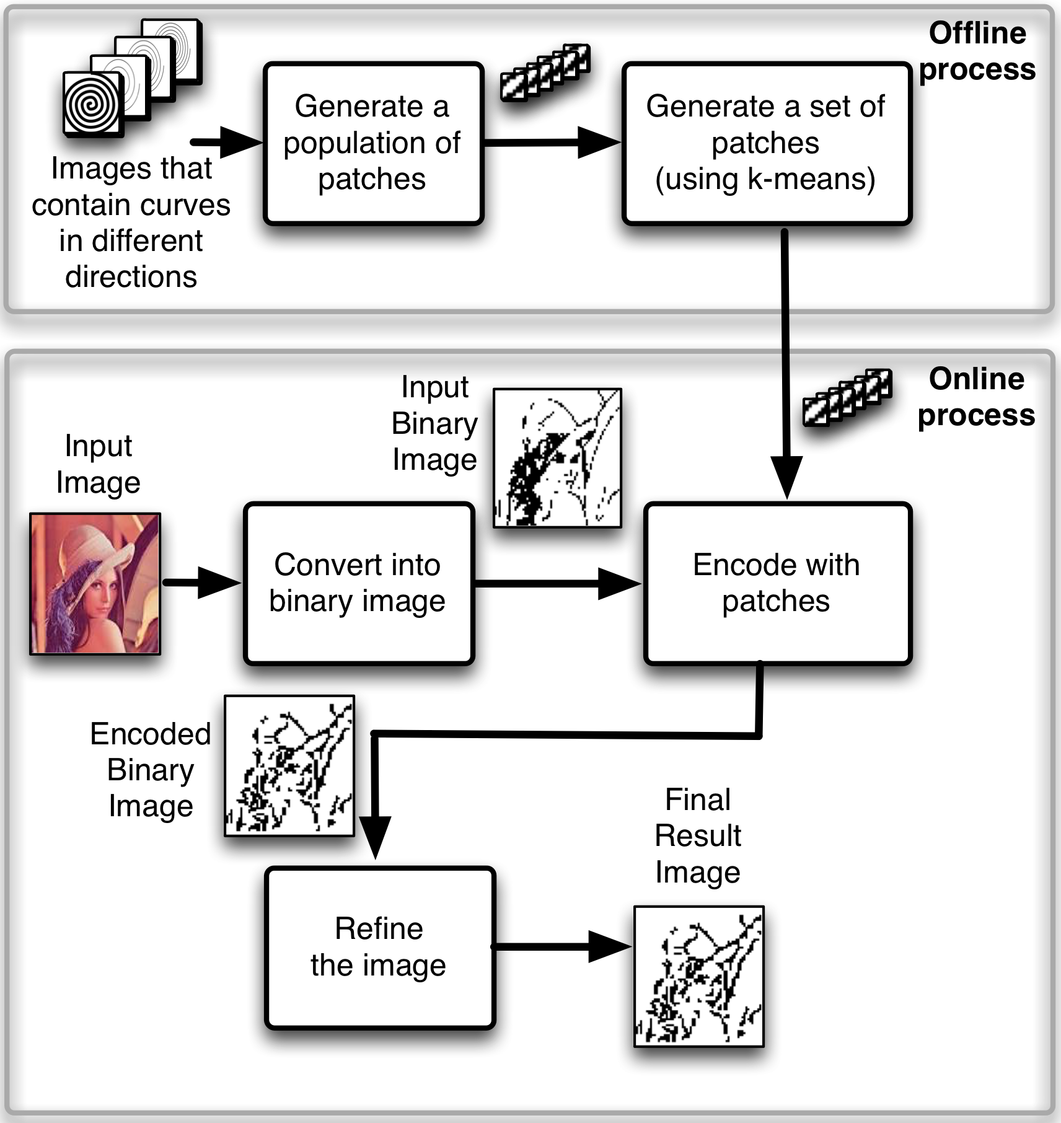
Overall Process
Notes:
We generate a large population of patches using images…
When we do k means

Slide 18



Evaluation
Varying parameters (beacon number, image type, k-means settings..)
Plot image quality vs. device lifetime.
Life time is estimated from API. We did not wait 60 months!
Notes:
alpha-numerical character, shapes, images,
Lena image and xxx
Basiccaly Evaluation goal is to tune the parameters, let us understand the impact of changes of different settings
The analysis is to analyze the approximated images quality vs device lifetime. Under different settings
such as different number of beacons and image quality, different type of images, and different parameters in k-means clustering …
Setting: has to arrive in 1s
The underline logic is that different settings will result in different encoding image size, which gives the number of packets transmitted under 1s, this impacts transmission frequency, turther device lifetime

Slide 19

Evaluation
Adding more Beacons gives a better image quality, but when the number of Beacons is larger than 3 the improvement is not significant.
Notes:
This plot shows the system performance using different number of beacons

Slide 20
Evaluation
K-means on multiple spiral patches performs better than using single spiral. K-means on MNIST patches outperforms K-means on spiral patches on the Alpha-Numeric dataset.
Notes:
This shows the image approximation performance for 3 types of images, here we also tried to make a patch generated from k-menas on MNIST handwritten digit dataset
For arbitrary image, k means on spirals is better when the available data storage capacity is more limited, but it does not do better than MNIST in high frquency setting
K = 64, patch size = 8 pixels

Slide 21

Reading-writing into Beacon
12 participants
Notes:
- WE also did some user study
-Goal: Test if the user write image can be read by another one
-12 participants
-We had drawing
-Better to expand in the whole screen, not being symbols that are easy to confused with other symbols “o”

Slide 22








Navigation test
5 participants
Notes:
-Goal: simulated remote navigation / hiking system
-5 participants
- deployed 6 beacons with navigation information in 6 locations in the building’2 and 3 floor
- follow the iamges from xx to xx, displayed on the screen
- route like this
- Free to give up
Finally we ask their idea of the clearness of the signs
－ 4 of 5 participants successfully completed the route,
1 gave up because of xxx
This drags down the user’s subjective socre of image 3
we believe with more careful deploying, the technology can be useful in customized navigation without internet connection
http://cs.unc.edu/files/2013/12/brooksbuildingsmall.jpg

Slide 23



Color image: approach
Region of interest
Foreground, adaptive encoding:
DCT
Wavelet
Triangle mesh
Background:
Down sample -> DCT
Notes:
Region of interest: foregorund / background
Allocate more bits describe the foreground
Still needs to preserve the background to give some context info

Slide 24
Segmentation
Generating an accurate segmentation
Apply a good encoding method for foreground region
Notes:
Single image-based, segmentaiton, such as watershed based method some times are not accurate,
Depth based method requires multiple view caputre, tends to be noisy
Combine the two results

Slide 25
Image encoding
Reduce mesh density
Reduce frequency component coefficients / quantization
Notes:
Foreground and background processed separately
We would like to control the size/quality of the foreground, For DCT wavelet, reducing the frequency compoent coeffs, for triangulariztio, we can reduce mesh desity

Slide 26
System
How to find a good pair of images?
- Use IMU signal
Notes:
Here we have another optimization here: the good pair of images may not be easy to find: the user may need to try many times.
We design and implemented a IMU guided capture

Slide 27
Evaluation
IMU-guided view capture
Sensor readings: rotation vector, acceleration vector
Train a decision tree model
Use the model and IMU reading to predict the good pair of images
Notes:
Reduce the time of find a good pair of images,
Training phase, we record the sensor data, labeled each one by the depth map qualty
Train decision tree model
Use to predicdt the good pair of iamges

Slide 28

Evaluation
Notes:
Contains road signs, buildings, indoor / outdoor bojects

Slide 29
Evaluation
Notes:
Green color curve: jpeg, Beat jpeg again

Slide 30
Evaluation
Varying image type
Varying number of
beacons
Notes:
:Plot 1 shows building images has larger part as foregrorund, this makes it cost more energy to deliver a good quality
Plot 2 Similar to the binary iamge case,

Slide 31


Evaluation (User Study)
Recognize objects
Notes:
Have four group of objects
Compress image of one object in every group,
Let participant guess which one it is

Slide 32
Future work
GIF images, videos
“Fat beacon”
Notes:
Could surrport GIFs or other videos
Beacon community and people in Google are talking about deveoping the fact beacon standard that is for storing/broadcatsing webpages inside beacon,how our method work with it may be a research topic (thumbnails)

Slide 33
Thank you Questions?

Slide 34
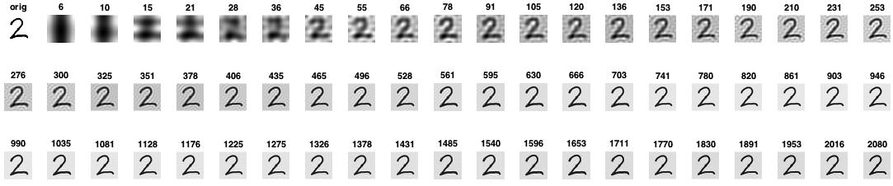

Slide 35
State of art image compression
JPEG2000
HEVC-MSP
https://people.mozilla.org/~josh/lossy_compressed_image_study_october_2013/
http://www.compression.ru/video/codec_comparison/wmp_codecs_comparison_en.html

Slide 36
SSIM

Slide 37
Notes:
#2. explain with a plot or numbers why BLE last multiple years (energy saving technology)
#3. Reference papers [X, Y, Z] perhaps.
#4. Name the arrows (add text to explain what each arrow means)
#5. More kinds of images: signs? real photos? shapes?
#7. More examples of usages?
#8. Mention lifetime requirement, mention no Internet required.
#9. Little more description/annotation
#10. Write iBeacon if it is.
#11. Add example images.
#12. Mention the quality number, what is changed? Is the last one your technique?
#13. SSIM metric here?
#14. Show an image and mark the patches - maybe an example: image -> patch numbers
#16. Define SSIM, CR; mark the gap between compression ratios
#19. Make 2 separate slides; Add a 'conclusion line' below each plot
#20. More on deplyoment setup: number of people, images, beacons, etc. Mention the goal of this experment: update the slide title.
#21. Add drawings -- arrows etc. Mention the goal of this experment: update the slide title.

